Slide 1




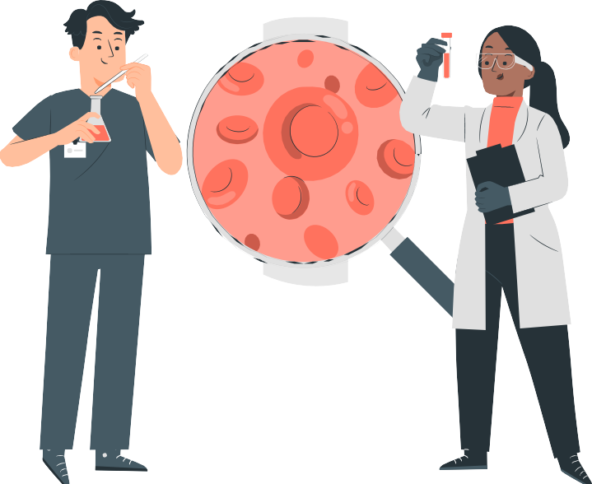






BANDI GAURAV SANDEEP
FINAL PROJECT

Slide 2

PROJECT TITLE
Transformers for Natural Language Understanding and Generation

Slide 3


Introduction
The architecture has revolutionized Natural Language Understanding and Generation by leveraging self-attention mechanisms. This presentation explores the advancements in achieved through Transformers.

Slide 4
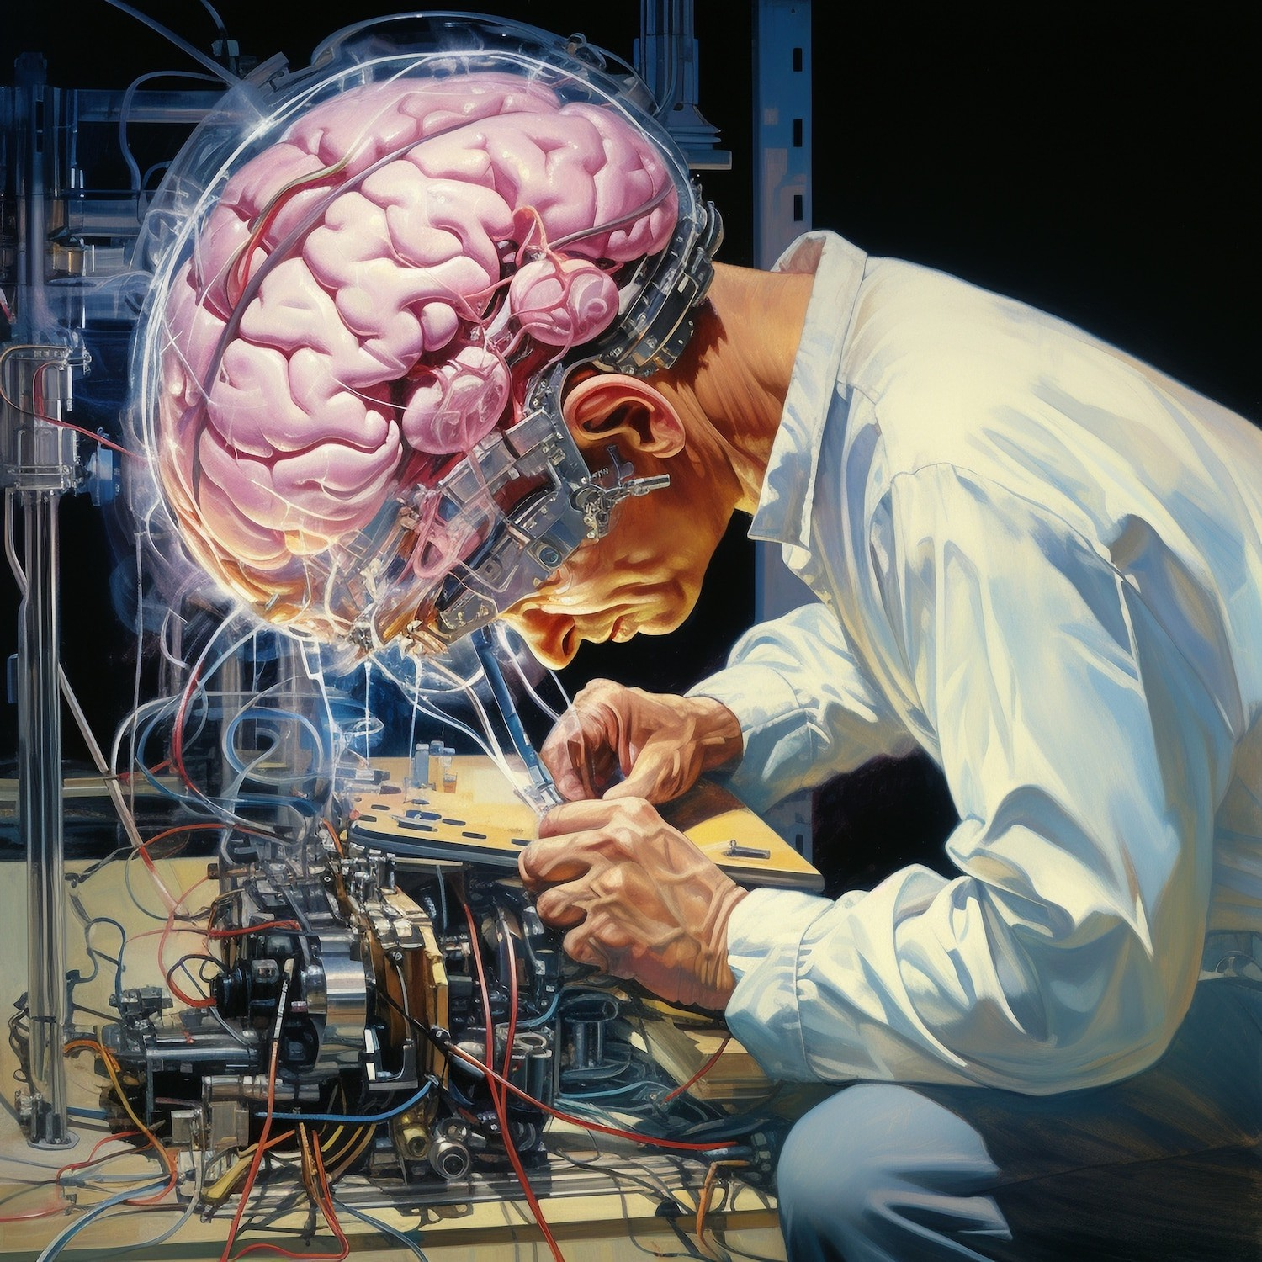
Self-Attention Mechanism
The allows each
word in a sequence to focus on other words, capturing long-range dependencies. This mechanism enables the Transformer to efﬁciently process input sequences.

Slide 5


Transformer Architecture
The architecture consists of an encoder and a decoder, utilizing multiple layers of self-attention and feed- forward neural networks. This architecture has demonstrated remarkable performance in various NLP tasks.

Slide 6
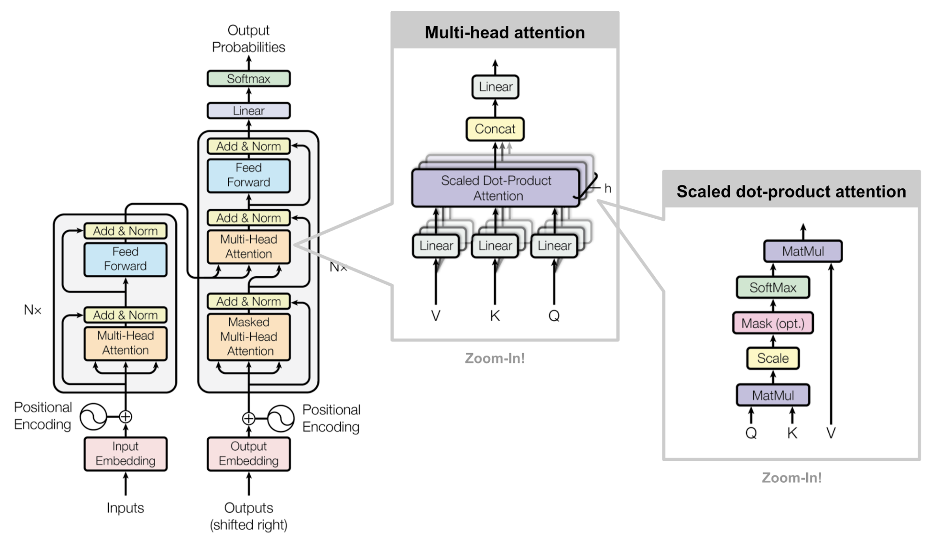

Slide 7
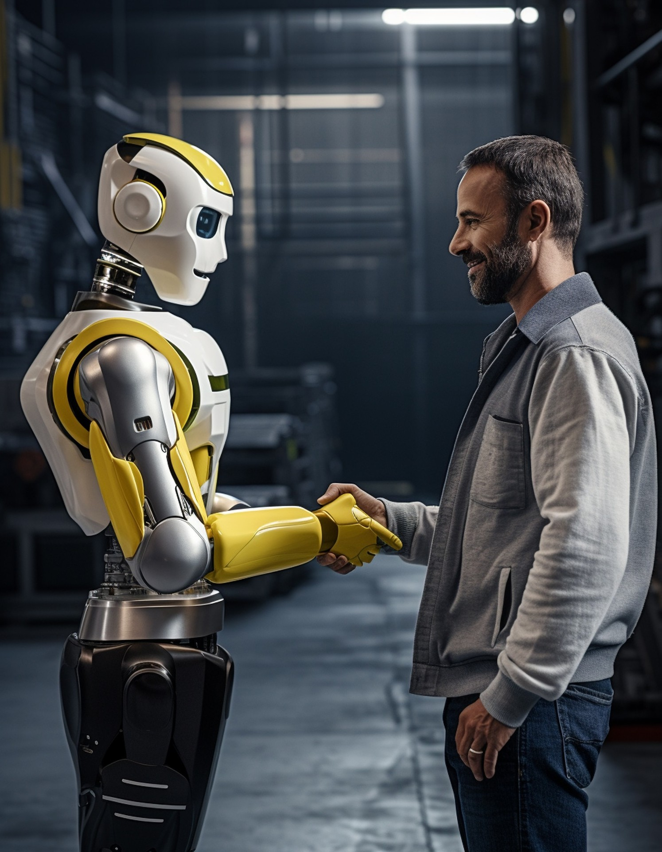
BERT and GPT-3
and are prominent examples of Transformer-based models. BERT excels in understanding context, while GPT-3 demonstrates exceptional generation capabilities, showcasing the versatility of Transformers.

Slide 8
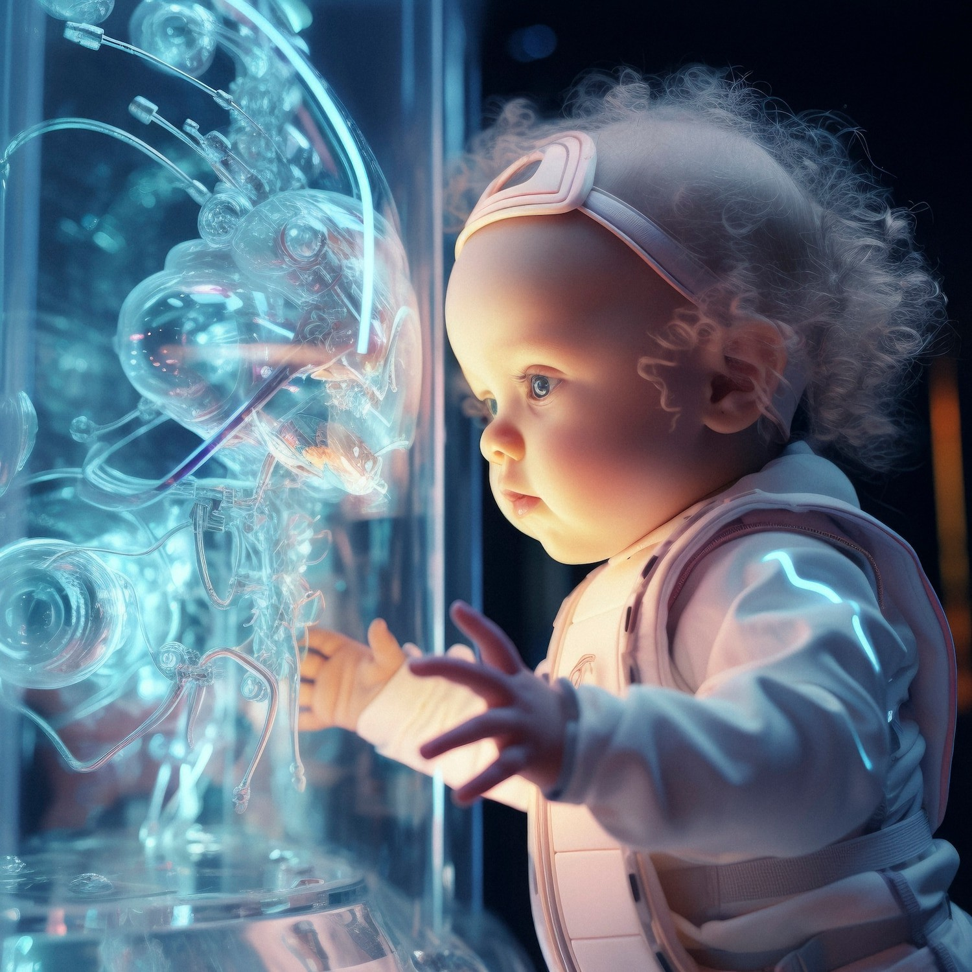
Applications in NLP
Transformers have been instrumental in improving tasks such as translation, summarization, question answering, and chatbots. Their ability to capture complex linguistic patterns has led to signiﬁcant advancements in NLP.

Slide 9
Comparing Transformers With Other NLP Models
Recurrent Neural Networks (RNNs)
RNNs are sequential models that process input data one element at a time, making them suitable for tasks like language modeling and speech recognition.
Convolutional Neural Networks (CNNs)
CNNs are typically used for computer vision tasks, but they can also be applied to NLP tasks by treating text as an image
Transformers
Transformers are attention-based models that can capture long-range dependencies in text, making them effective for tasks like machine translation and text generation.

Slide 10

Conclusion
Transformers have signiﬁcantly elevated the capabilities of NLP systems, enabling more accurate understanding and generation of natural language. Their impact extends across various domains, promising further innovations in the future.

